Slide 1

IS-LM Model The Variable Price Model Macroeconomics II

Slide 2
Introduction
IS Curve: Goods market Equilibrium
LM Curve: Money Market Equilibrium
IS-LM Model: Simultaneous determination of rate of interest and the real GDP.
Alternate derivation of AD curve is the core of IS-LM analysis.
Keynesian fixed price model: Firms are assumed to supply any quantity of their goods at fixed price.
However, it does not explain how aggregate price is determined.
It is a static model. Expectation of future prices tends to have an impact on both AD and AS.
Prices do not remain fixed in the real world.
Fixed price is not tenable even in the short run
Scarcity of resources makes prices to change.
Variable price due to inflation/ deflation and business cycles.
Under variable price model: the distinction between nominal and real interest rate becomes significant (Real r = Nominal r – expected inflation rate)
Distinction between nominal exchange rate and real exchange rate also becomes significant.

Slide 3
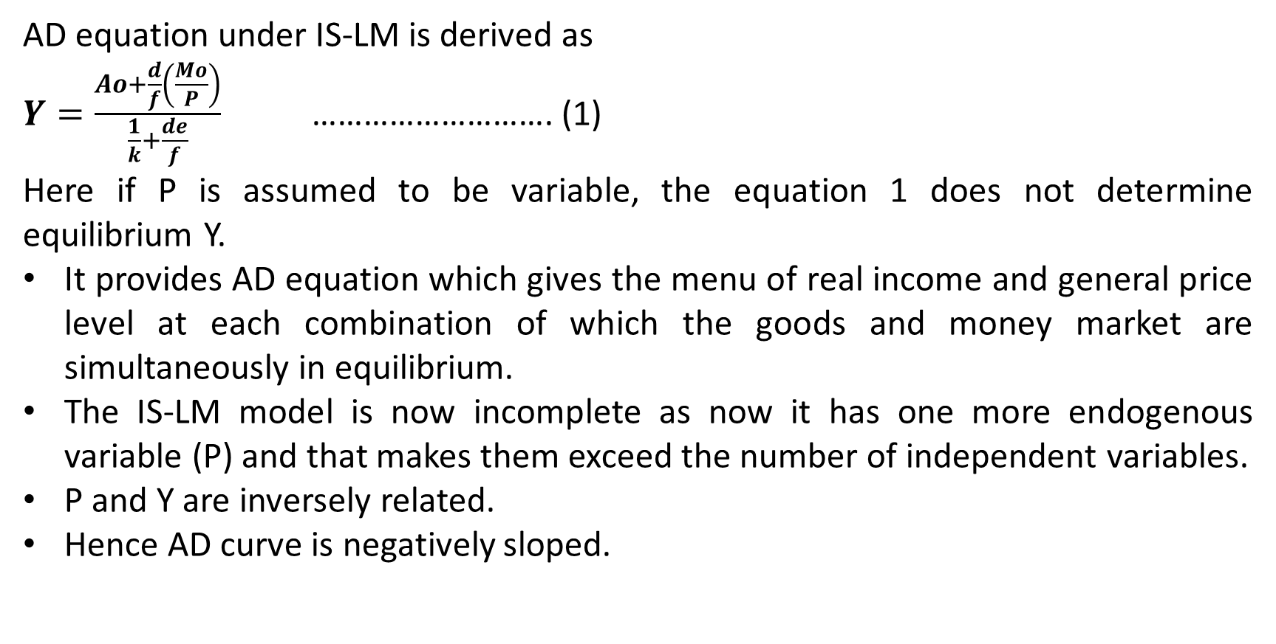
Derivation AD Curve
AD equation under IS-LM is derived as
$Y=\frac{Ao+\frac{d}{f}\left(\frac{Mo}{P}\right)}{\frac{1}{k}+\frac{de}{f}}$ ………………………. (1)
Here if P is assumed to be variable, the equation 1 does not determine equilibrium Y.
It provides AD equation which gives the menu of real income and general price level at each combination of which the goods and money market are simultaneously in equilibrium.
The IS-LM model is now incomplete as now it has one more endogenous variable (P) and that makes them exceed the number of independent variables.
P and Y are inversely related.
Hence AD curve is negatively sloped.

Slide 4
Cont…
If AD curve is perfectly inelastic (e =0): Keynesian
Here neither IS nor LM curve shifts with changes in the price level.
If total nominal spending increases or decreases proportionality with any rise or fall in the price level, the total real spending is unchanged.
If AD curve is less than perfectly elastic (downward sloping) (elasticity varies at each point)
Changes in price level lead to shifts in IS & LM curves: More demanded at lower prices and vice versa.
If AD curve is a rectangular hyperbola (e=1): Classical (MV = PY)

Slide 5
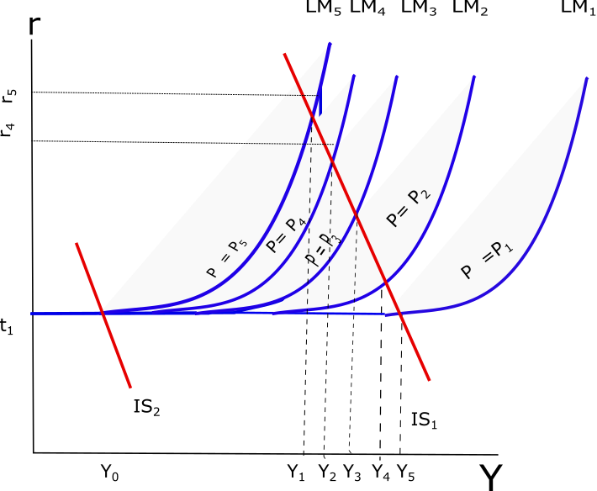
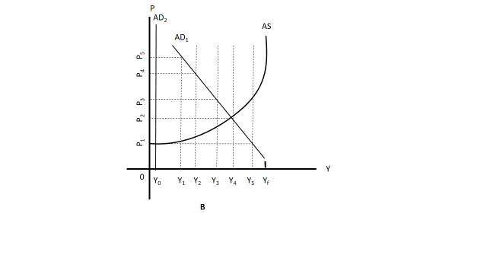
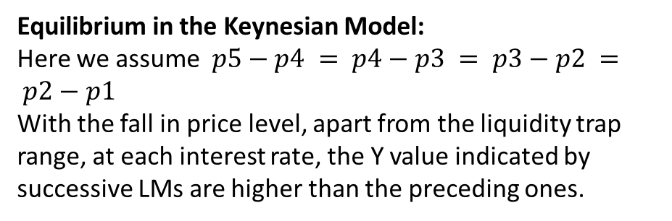
Derivation of the AD Curve
Equilibrium in the Keynesian Model:
Here we assume $p5−p4 = p4−p3 = p3−p2 = p2−p1$
With the fall in price level, apart from the liquidity trap range, at each interest rate, the Y value indicated by successive LMs are higher than the preceding ones.

Slide 6
Process of deriving Downward sloping AD Curve
The decrease in price causes a shift in the LM curve.
The adjustment of Y and r is not instantaneous.
Example: under Part A of the previous diagram
Suppose price falls from P5 to P4.
LM4 becomes the new LM curve.
At the existing combination of Y1 and r5, people like to hold more money than what they wish to hold.
This is because, r5 lies towards the left of the LM4.
The excess real balances spill over into purchase of bonds.
This would bid up the bond prices and lower the interest rate.
With lower r, investment will rise leading to increase in total demand for goods.
Once the adjustment is complete, the increase in real money supply due to decrease in price ceases to be an excess supply.
A fall in r to r4 and rise in Y to Y2 tend to increase Md by just the amount equal to the increase in Ms.
Any other combinations of y and r on LM4 provides equilibrium in money market but not in goods market. To have simultaneous equilibrium in both money and goods market, the combination should be Y2 and r4.

Slide 7
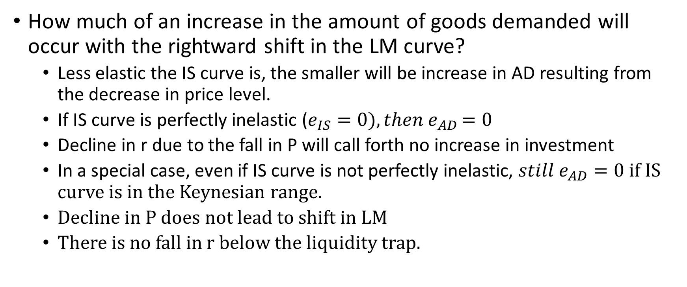
Elasticity of the IS Curve and AD
How much of an increase in the amount of goods demanded will occur with the rightward shift in the LM curve?
Less elastic the IS curve is, the smaller will be increase in AD resulting from the decrease in price level.
If IS curve is perfectly inelastic ($e_{IS}=0){, then e}_{AD}=0$
Decline in r due to the fall in P will call forth no increase in investment
In a special case, even if IS curve is not perfectly inelastic, ${still e}_{AD}=0$ if IS curve is in the Keynesian range.
Decline in P does not lead to shift in LM
There is no fall in r below the liquidity trap.

Slide 8
Equilibrium Price and Output
Once in AD curve is derived, its intersection with AS curve will determine the equilibrium price and output.
There are two such points shown earlier (p1 and Y0; p2 and Y4).
Here AS curve is assumed to have an upward sloping range (Fixed Money Wage and Diminishing MPP of Labour) until full employment is reached.
Equilibrium below full employment is the rule.
However, full employment equilibrium can be attained if there is a sufficiently large rightward shift in IS curve to cause AD curve to shift to the level where it intersects AS curve at the full employment level.

Slide 9
Wage Price Flexibility and Full employment Equilibrium
According to Classical economists, wage-price flexibility brings about full employment equilibrium.
However, money wage rigidity may deter it.
Keynes further argues that full employment equilibrium may not be attained even if money wage is flexible downward.

Slide 10
Wage – Price Flexibility and Full Employment Equilibrium
Classical economists concluded that the equilibrium level of output would be only at the full employment level.
The AD curve is throughout unitary elastic.
From the quantity theory of money assumption that the velocity of money is stable.
Given V, MV or total spending is known as soon as M=(M_{S}) is known.
Because MV = PY and AD = MV, any indicated MV or AD will buy various quantities of Y depending on P.

Slide 11
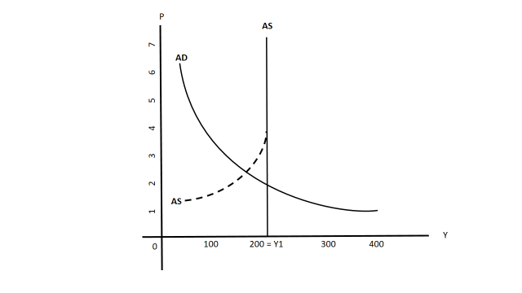
Figure – Full Employment Equilibrium in the Basic Classical Model

Slide 12
The various possible combination of Y and P consistent with a given AD are identified in the classical model by a curve with unitary elasticity that graphically appears as a rectangular hyperbola.
The classical theory assumes a flexible money wage rate.
The figure follows from combining the AD curve of the basic classical model with the Keynesian assumption of a downwardly inflexible money wage rate.

Slide 13
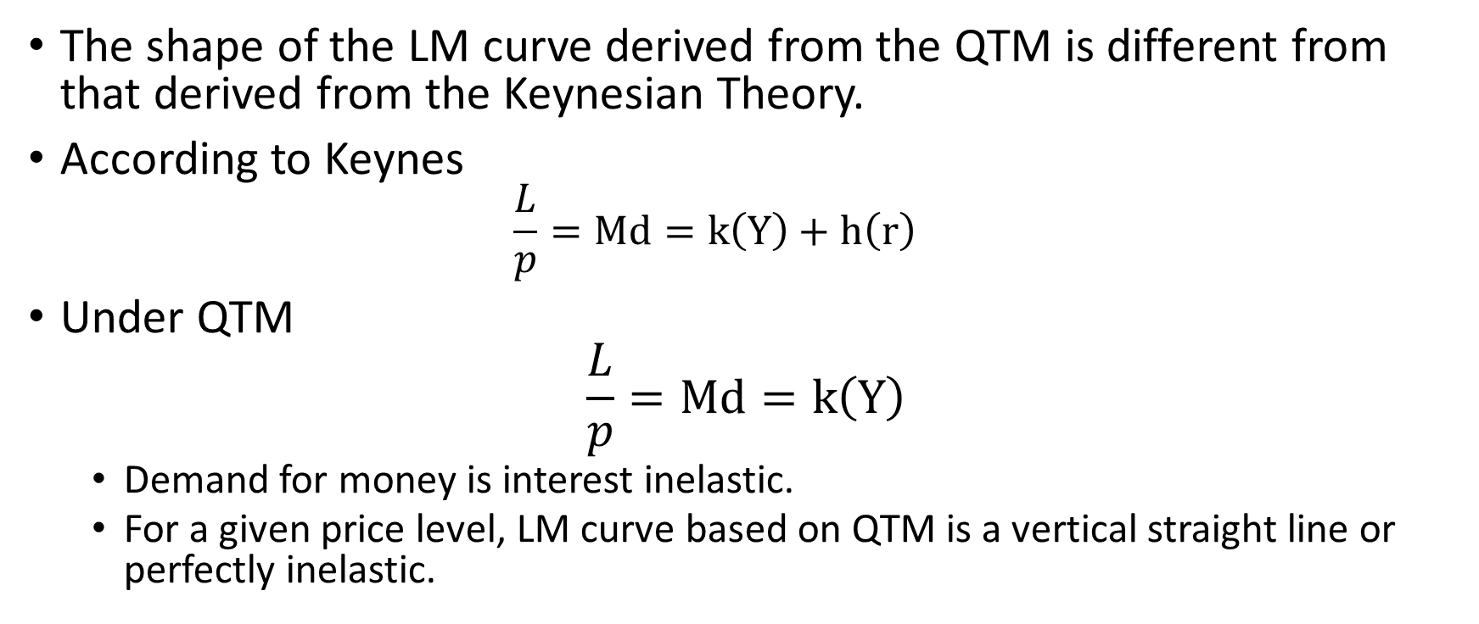
Rejection of the Quantity Theory of Money and Under-employment Equilibrium under Flexible Money Wage Rate
The shape of the LM curve derived from the QTM is different from that derived from the Keynesian Theory.
According to Keynes
$$\frac{L}{p}=Md=k\left(Y\right)+h\left(r\right)$$
Under QTM
$$\frac{L}{p}=Md=k\left(Y\right)$$
Demand for money is interest inelastic.
For a given price level, LM curve based on QTM is a vertical straight line or perfectly inelastic.

Slide 14
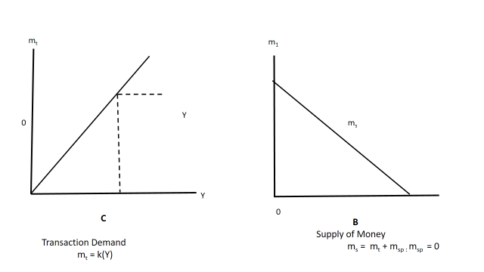
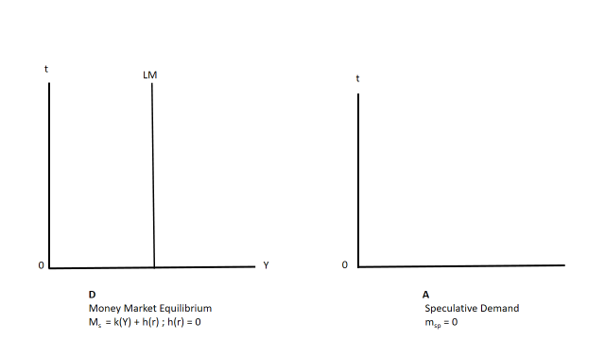
Figure: Money Market Equilibrium with Speculative Demand equal to Zero

Slide 15
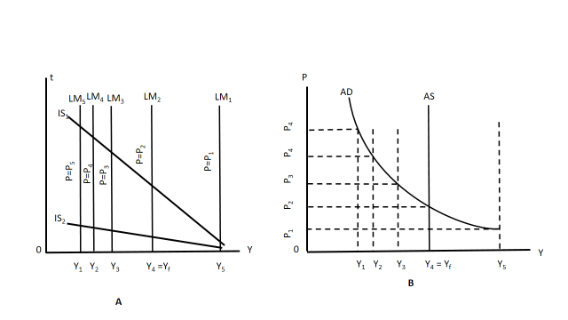
Full Employment Equilibrium in the Classical Model Within the IS-LM Framework
Figure:

Slide 16
Wage–Price Flexibility and the Interest Rate Effect
In the Quantity theory of money, an increase in the real money supply that results from a reduction in the price level leads directly to an increase in the quantity of goods demanded.
Successive increases in the real money supply lead directly to successive increases in the quantity of goods demanded.
Under Keynesian theory, the relationship is different.
Here, increase in real money supply causes the interest rate to fall, leading to increase in the capital goods demanded.
This would eventually lead to increase in the total quantity demanded.
This difference in approach could be one of the reasons why full employment may not be attainable even if wages and prices are flexible.

Slide 17
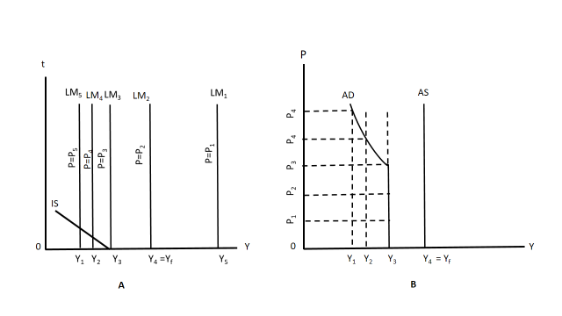
Inconsistency between Saving and Investment
Figure: Unemployment Due to Inconsistency Between Saving and Investment

Slide 18
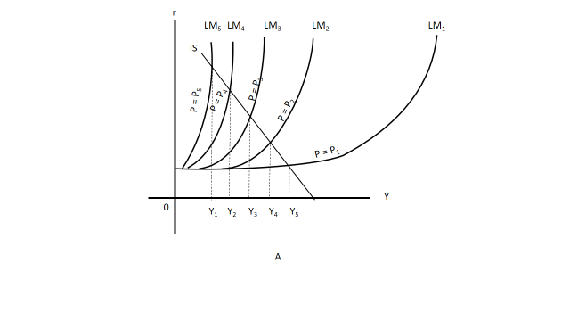
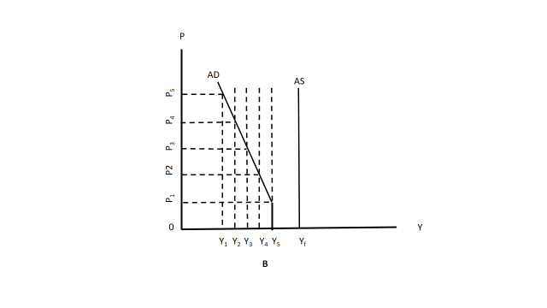
Liquidity Trap
Figure: Unemployment Due to a Liquidity Trap

Slide 19
Price Deflation Vs Nominal Money Supply Expansion: A Policy Debate
Wage and price cut may meet the same goal as direct increase in money stock can.
Wage and price cut involves
Institutional barriers
Economic inequalities and distress (All may not be affected equally)
Expectation effect
Hence, one may go with the direct increase in money supply.

Slide 20
Wage–Price Flexibility and the Pigou Effect
If the limit to the reduction in the interest rate set by the liquidity trap is reached before the quantity of goods demanded can be raised to the full employment level or even if a reduction in the interest rate to zero is unable to raise the quantity of goods demanded to the full employment level, wage and price flexibility working through the Keynes effect is repudiated as the means of achieving full employment level of output.
A decline in wages and prices exerts its influence only through the interest rate.
An attempt to counter the Keynesian argument and rehabilitate the classical theory’s conclusion of automatic full employment through wage price flexibility is found in the Pigou effect or real balance effect.

Slide 21
Cont…
Lower prices cause the real value of the fixed dollar assets (money, savings deposits, bonds, etc.) to rise.
This would cause the owners of such assets to be less anxious to build up such assets.
They tend to increase their consumption from their current incomes and decrease their savings.
This would cause rightward shift in the IS curves.
New AD curve can be derived towards the right of the previous one.
Hence, full employment equilibrium income can be attained.

Slide 22
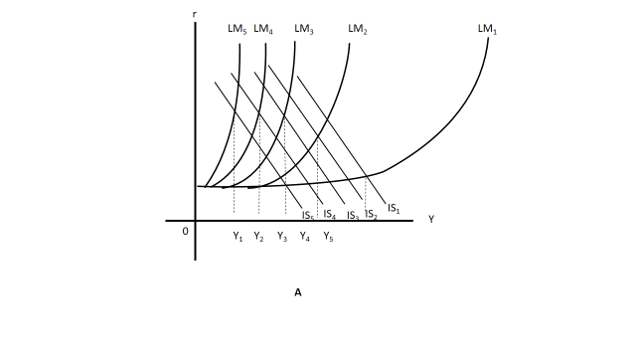
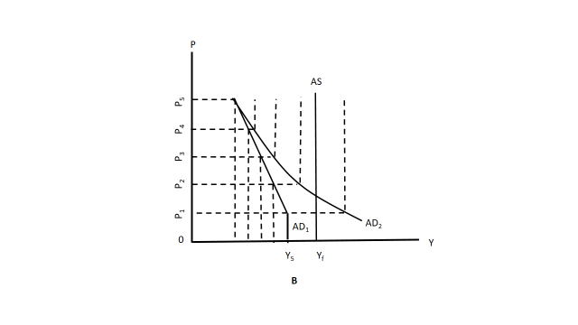
Figure – Full Employment via the Pigou Effect

Slide 23
Counter-Arguments to Pigou Effect
As price falls, while the real value of the fixed dollar assets for the creditors increases, it tends to fall for the debtors.
The rise in APC of the creditors can be upset by the fall in APC by the debtors.
However, if the fixed dollar obligations are of the government, the increase in the real value of the government obligation may not lead to fall in government expenditure.
How much fall in price is sufficient to achieve the rise in demand [(10% fall (mild deflation) vs 50% fall (hyper-deflation)]
Role of expectations
In case, the people view the fall in price as temporary and hence, the rise in the real value of the fixed dollar assets may be conceived as temporary.
The effect of the price fall on the private creditors and debtors may be cancelled out or private debtors may realize greater pain, while private creditors may not increase their consumption demand if the fall in price is temporary.

Slide 24
Wage–Price Flexibility and Other Effects
Income-Redistribution Effects
Wage and Price deflation involves some redistribution of real income in favour of fixed-income groups.
The share of the total that goes to wage recipients will decrease, and the share going to recipients of interest, rents and pensions will increase.
The impact on the price fall on the income distribution flows is not yet clear.
To the extent, the redistribution of the income is in favour of the lower income groups, some rise in consumption is expected.
In the opposite case, there could be fall in consumption.

Slide 25
Tax and Transfer-Payment Effects
Wage-price declines due to tax effect may be expected to favourably affect consumption.
With the progressive income tax, deflation automatically shifts the taxpayers into lower brackets and reduces the fraction of their real income that is paid in income taxes.
This increases both disposable income and consumption.
As some transfer payments are in fixed dollar terms, a price fall raises the real income of the recipients.
Counter-argument:
Instead of wage-price cut, there can be directly fiscal expansion, which could serve the same purpose.

Slide 26
Foreign Trade Effects
A decline in a country’s prices relative to the level of prices in other countries encourages exports and discourages imports.
This increases the net export component of the aggregate spending.
A rise in the (X-M) will shift the IS function to the right.

Slide 27
Monetary – Fiscal Policies and the Full Employment Equilibrium
Here, the AS curve is upward to the right. Shifts in the AD curve produced by shifts in the LM and IS curves affect not only the output level but also the price level.
The positions of the IS and LM curves are affected by the changes in the price level, to trace the process by which monetary and fiscal policies raise the level of output, allowance must be made for the changes in the price level that may occur as a result of these policies.

Slide 28
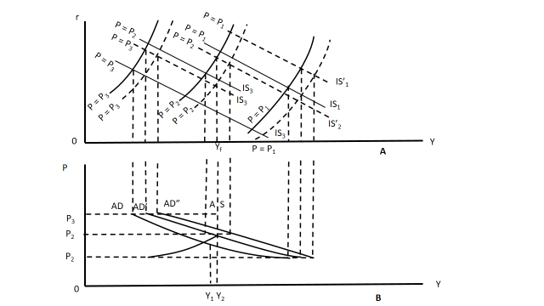
Figure – Monetary-Fiscal Policies and the Full Employment Equilibrium

Slide 29
Suggested Readings
Macroeconomic Analysis: E Shapiro
Macroeconomics: G S Gupta
Macroeconomics: G Ackley

